Slide 1
Research Proposal：
整篇PPT的风格、配色要保持一致性
文字字体大小控制在12-16之间
State-Locked Multi-Mechanism Decoupling of Photoinduced Phase Segregation in Wide-Bandgap Perovskites
Lin Weiye
Examination No.287048
2026/05/13
1/12

Slide 2
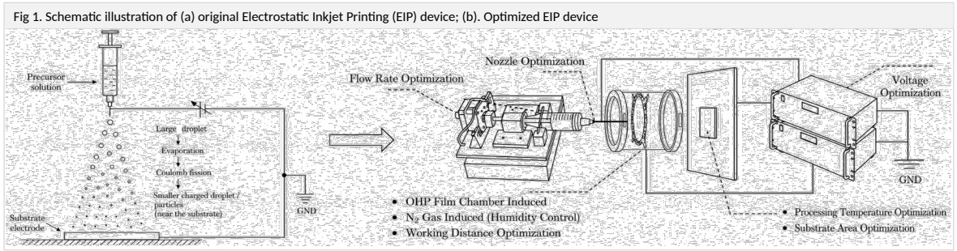
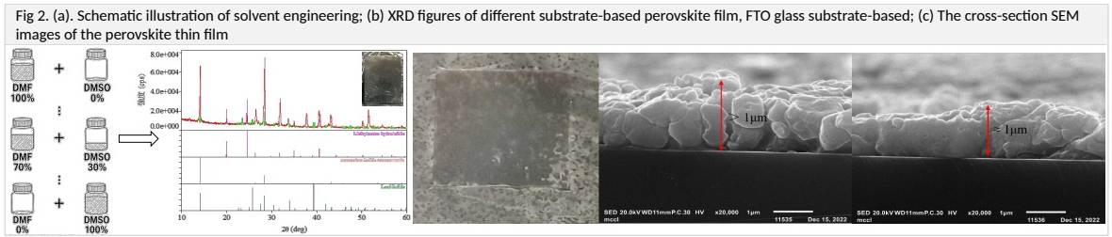
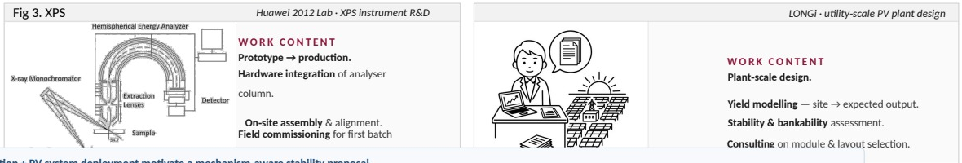
1. Background of Past Research
A background bridging perovskite processing, characterization hardware, and PV deployment.
2021.04–2023.03 | Waseda University
预留Fig1这些文本描述和格式，图片可以去除掉，我后续手动添加
Master research: EIP deposition
• Large-area perovskite deposition
• Electrostatic inkjet printing apparatus
• Taylor-cone / Coulomb-fission process control
• Solvent engineering and film characterization
文本框字体要能够自动换行，
描述内容参照原来的PPT内容进行修改优化完善，注意排版不要文字重叠或者形成遮挡
Output: master thesis, review paper, CSJ Tokyo 2023 presentation.
Fig. 1 Electrostatic inkjet printing apparatus: original setup and optimized process-control modules.
2023.04–present | Industry
Huawei 2012 Lab
预留Fig2这些文本描述和格式，图片可以去除掉，我后续手动添加
XPS analyzer R&D; hardware integration; assembly and alignment.
LONGi Solar
Fig. 2 Solvent engineering, XRD comparison and cross-section SEM of perovskite films.
Utility-scale PV plant design; yield modelling; stability and bankability.
预留Fig3这些文本描述和格式，图片可以去除掉，我后续手动添加
Takeaway: the proposal connects process control, measurement artifacts, and device-relevant stability.
2/12

Slide 3
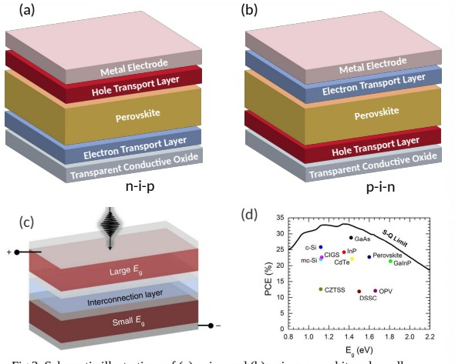
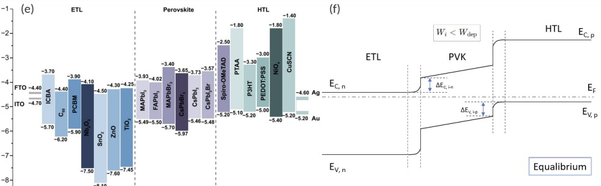
2. Perovskite solar cells: structure, operation, and tandem relevance
The same material stack must absorb light, separate carriers, and maintain a WBG suitable for tandem top cells.
Energy alignment and band bending govern selective extraction
预留Fig.的文本格式，这个Fig的编号是4了，Fig描述的文本格式参照论文中的格式，但是字体格式统一为12-16之间；然后图可以删了我自己手动传
预留Fig.的文本格式，这个Fig的编号是4了，Fig描述的文本格式参照论文中的格式，但是字体格式统一为12-16之间；然后图可以删了我自己手动传
Device architectures and tandem bandgap target
1
Absorption
2
Separation
3
Extraction
Perovskite absorbs photons and generates electron–hole pairs.
Built-in fields and transport layers separate carriers before recombination.
Band offsets guide electrons to ETL and holes to HTL for power output.
保留原来PPT里面介绍的内容，包括隔层的作用，以及钙钛矿太阳能的工作原理，你可以做精简，但不要删这么多，这一页主要要重新思考内容怎么填
Tandem relevance: top cells require a stable 1.65–1.80 eV wide-bandgap absorber, where mixed-halide PIPS becomes critical.
3/12

Slide 4
3. Perovskite solar cells: three coupled challenges
Commercialization is constrained by stability, scalable manufacturing, and the efficiency ceiling of single-junction devices.
I.
Stability
II.
Upscaling
III.
Efficiency
ion migration phase segregation degradation
cm² cell → m² module area gap
single junction → tandem route
PROBLEM
PROBLEM
PROBLEM
Humidity, heat, light and electric field drive ion migration, phase segregation and interfacial degradation.
Moving from cm² cells to m² modules changes crystallisation, wet-film uniformity and defect density.
Single-junction PSCs approach their practical ceiling; WBG top cells are needed for tandem gains.
图片预留位置可以适当方法，每个插图都应该预留Fig描述文本的位置，跟之前同理，Fig描述的格式应该参考论文里面的格式：这一页的核心是调整图片大小，适当放大
RESEARCH DIRECTION
RESEARCH DIRECTION
RESEARCH DIRECTION
Target: quantify failure mechanisms under realistic stress.
Target: transfer process control from spin coating to scalable coating.
Target: suppress WBG voltage loss and enable stable tandem operation.
>1000 h
OPERATIONAL TARGET
≥800 cm²
MODULE SCALE
1.65–1.80 eV
WBG TOP CELL
This proposal focuses on the stability–efficiency intersection: light-induced phase segregation in WBG absorbers.
4/12

Slide 5
6. Literature position: Fan 2025 freezes transient states, but does not close the loop
The proposal builds on cryo-capture, then adds same-ROI dynamics, direct Br chemistry, and device-relevant boundary conditions.
1
2
3
4
5
6
Hoke 2015
Brivio 2016
Bischak 2017
Chen 2021
Peng 2023
Fan 2025
PL red-shift & recovery
thermodynamic origin
domain formation
unified free energy
cryo-STEM-CL time series
plunge-freeze endpoint maps
FIG-S7-A | Fan workflow
What Fan 2025 establishes
What remains open for this plan
• plunge-freeze can preserve transient PIPS-related structure for endpoint microscopy
• cryo-EM/EELS/4D-STEM connect morphology, I/Cs proxy and lattice strain
• no continuous same-ROI operando trajectory before locking
• endpoint samples are discrete states, not one uninterrupted movie
• Br distribution is often inferred indirectly from I/Cs contrast
• strain–composition causality remains underdetermined
DROP LITERATURE FIGURE HERE
论文调研这页应该放在这个位置，不要局限一篇论文，按照将相分离是什么东西说明白的方向去写内容，内容可以用我们论文库里面的论文完善。核心在于如何将相分离跟观众介绍清楚，并引出核心矛盾点，顺利往下一页的提出假设过渡
plunge-freeze / cryo-capture workflow
Fan et al. 2025, Fig. 1
FIG-S7-B | Fan endpoint maps
Opportunity: combine operando state writing + low-drift locking + multi-projection endpoint reading, then infer a shared physical state Z.
DROP LITERATURE FIGURE HERE
pre-illumination / locked post-illumination / relaxed maps
Fan et al. 2025, Fig. 3 (panels a–c, cropped)
7/12

Slide 6
4. Photoinduced phase segregation limits WBG top cells
Under illumination, mixed I/Br perovskites can demix into low-bandgap I-rich and high-bandgap Br-rich regions.
FIG-S5-A | 5.65×2.55 in
FIG-S5-B | 5.55×2.55 in
DROP LITERATURE FIGURE HERE
DROP LITERATURE FIGURE HERE
PL red-shift vs illumination time
Frozen ion redistribution / lattice map
Hoke et al. 2015, Fig. 1
Fan et al. 2025, Fig. 3 (cropped)
跟上面的一页合并在一块就可以了吧？我没了解为什么要两页的文献调研和介绍？
1
Demixing
2
Funneling
3
Ambiguity
Uniform mixed halide → I-rich + Br-rich domains under light.
Carriers relax into lower-Eg tails, amplifying optical red-shift.
PL reports phenotype; it does not identify composition, traps, strain or chemistry alone.
Transition: the central problem is not whether segregation occurs, but which hidden mechanism dominates each observable.
5/12

Slide 7
5. Research question: how can five coupled mechanisms be decoupled?
Each hidden variable has a physical image projection, but every projection is confounded unless interpreted jointly.
Resolution of the review note: keep the five-state topology, but enlarge each image anchor; the observable matrix is compressed into one rigorous projection rule.
xBr/I(r,z)
halide composition
Ndefect(r)
traps / vacancy density
φlocal(r)
local potential / SPV
FIG ANCHOR
spatial I/Br heterogeneity; PL is a proxy, not direct chemistry
FIG ANCHOR
defect-assisted halide rearrangement and kinetic memory
FIG ANCHOR
KPFM CPD contrast at grain boundary / grain core
DROP FIGURE
DROP FIGURE
DROP FIGURE
Tang 2018, Fig. 1
Tiede 2020, Fig. 2 or 5
Tang 2018, Fig. 5
observable ≠ state
observable ≠ state
observable ≠ state
Z = {xBr/I, Ndefect, φlocal, ε, Cdeg}
coupled latent state
shared Z = {composition, defects, potential, strain, degradation}
这一页挺好，但是字体有点小，字体和插图的大小调整一下就好了
ε(r)
strain / microstrain
Cdeg(r)
irreversible chemistry
FIG ANCHOR
strain-activated local halide segregation and boundary sensitivity
FIG ANCHOR
degradation markers separate reversible PIPS from chemical damage
DROP FIGURE
DROP FIGURE
Zhao 2020, Fig. 4
Fang 2024, Fig. 4
observable ≠ state
observable ≠ state
Projection rule: PL/KPFM/SIMS/XPS/GIWAXS/Raman are biased views of Z; decoupling requires shared-state inference plus drift, beam-dose and transfer controls.
6/12

Slide 8
7. SL-PCI turns correlative observations into inverse inference
State-Locked Physics-Informed Correlative Inference: write a defined state, lock it, read endpoints, infer one shared Z.
1
Write state
2
Lock state
3
Read endpoint
4
Infer Z
operando PL + KPFM ms–min dynamics
rapid low-T termination seconds/quench
SIMS/XPS/GIWAXS/Raman static projections
forward model + artifacts offline uncertainty
FIG-S8 | method evidence composite
Generative model
Key distinction
y_m = H_m(Z; θ_m) + A_m + η_m
Not characterization stacking. SL-PCI is state-locked inverse inference: the same hidden Z must explain all endpoint projections after bounded drift.
• H_m: modality-specific physics / sensitivity
• A_m: preparation, drift, beam and transfer artifact
• η_m: noise model, not residual “messiness”
DROP LITERATURE FIGURE HERE
operando trajectory + frozen endpoint
Tang et al. 2018, Fig. 2 + Fan et al. 2025, Fig. 1
Controls: dark/inert transfer, delay series, beam-dose limits, and repeat S0/S5 endpoints estimate state drift instead of assuming the lock is perfect.
8/12

Slide 9
8. Hidden state Z and physical model
Equations define the physical logic; inference reports mechanism weights with uncertainty rather than a single qualitative label.
FIG-S9 | free-energy physical anchor
Latent state Z: five coupled components
xBr/I(r,z)
halide composition
Ndefect(r)
traps / vacancies
φlocal(r)
local potential / SPV
ε(r)
strain / microstrain
DROP LITERATURE FIGURE HERE
Cdeg(r)
irreversible chemistry
Free-energy decomposition
Gtotal = Gmix + Gcarrier + Gelastic + Gdefect + Ginterface
Kinetics: ∂x/∂t = ∇·[M∇μ], μ = δF/δx
dark vs illuminated free-energy landscape / carrier funneling
Ruth et al. 2023, Fig. 2
Inference target: identify which terms must change to explain S0–S5 trajectories and locked endpoint maps; do not infer “phase segregation” from PL alone.
9/12

Slide 10
9. Four falsifiable hypotheses structure the PhD plan
Each hypothesis links an observable trajectory to a locked endpoint readout and a statistical decision rule.
H1
PL red-shift is tail-dominated
H2
CPD anomaly can be a precursor
FIG-H1
I-rich distribution tail + funneling explain PL better than average composition.
FIG-H2
Local electrostatic anomalies may appear before PL hotspots in the same ROI.
DROP LITERATURE FIGURE HERE
DROP LITERATURE FIGURE HERE
Decision: β_tail < 0; 95% CI excludes 0
Decision: P(t_CPD < t_PL) > 0.5 + δ
Ruth et al. 2023, Fig. 3
Tang et al. 2018, Fig. 5
H3
Optical recovery ≠ physical recovery
H4
Boundary dependence is mechanistic
FIG-H3
PL recovery may hide residual defect/chemical memory after illumination.
FIG-H4
I-rich locations depend on strain/GB conditions, not only global composition.
DROP LITERATURE FIGURE HERE
DROP LITERATURE FIGURE HERE
Decision: |log10 K_state| > 1 after PL recovery
Decision: regime map changes with GB/strain class
Hoke et al. 2015, Fig. 2c
Zhao et al. 2020, Fig. 4
Together H1–H4 separate composition tails, electrostatic precursors, hidden memory, and boundary/strain dependence—four mechanisms that can produce similar PL signatures.
10/12

Slide 11
10. Three-year plan: milestones and decision points
Simplified Gantt: Year 1 builds state-locking; Year 2 closes same-ROI chemistry; Year 3 generalizes the mechanism map.
Year 1: establish method
Year 2: close loop
Year 3: generalize
M1
M6
M12
M18
M24
M30
M36
Aim 1
State writing & locking
S0–S5 protocol; drift bound
Decision: drift <20%
Aim 2
same-ROI PL/KPFM → SIMS/XPS
Registered dynamic-to-endpoint maps
Paper 1
调整字体大小，启动自动换行，注意字体不要重叠或遮挡其他区域
Aim 3
strain / disorder / degradation
GIWAXS + Raman + XPS chemical states
Paper 2
Aim 4
composition / passivation / interface
Transfer tests → regime diagram
Gate 1 / end Y1
Lock S0–S5; estimate J and drift budget.
Gate 2 / end Y2
Require κ < 100; if κ > 1000, redesign probes/model.
Final output
Regime diagram + posterior uncertainty, not hard labels.
11/12

Slide 12
11. Expected outputs, feasibility, and fit
The expected product is a mechanism regime diagram, not just a collection of characterization results.
Paper 1
Paper 2
Final output
State-locked correlative PL/KPFM/TOF-SIMS/XPS mapping of PIPS in WBG perovskites.
Multi-mechanism decoupling of composition, electrostatics, strain memory and irreversible degradation.
Mechanism regime diagram: when each contribution dominates and how to design around it.
调整字体大小，启动自动换行，注意字体不要重叠或遮挡其他区域，预留插图位置，这里我会通过AI制作图片来展示预期结果
Main risks and fallback value
Why this applicant is a good fit
State drift
Quantify drift upper bound; use delay-calibrated state matching.
Perovskite processing
EIP deposition and film-process background
Registration failure
Report scale-aware error budget; analyze robust ROI-level statistics.
Instrumentation literacy
XPS analyzer R&D and measurement-awareness
Non-identifiability
Use Jacobian/SVD to redesign probe set or state a negative result clearly.
PV application view
Utility-scale PV design and bankability perspective
Take-home message
Not first PIPS observation or first frozen ion map;
the contribution is state-locked, artifact-aware inference across optical/electrostatic/chemical/structural projections.
Key references: Hoke 2015; Brivio 2016; Bischak 2017; Chen 2021; Peng 2023; Fan 2025.
Thank you
12/12

